Slide 1
Data Science Hire

Slide 2
Recommendation
Hire a data science engineer or analytics engineer
The salary range for a senior level position is $130,000 to $196,000
As a small company, the pay range will most likely be in the lower half of this range: $130,000 to $162,000.
If the position is remote, then:
For 20% to 80% remote we would look at the bottom half of this range: $130,000 to $146,000
For 0% remote we can look at the mid-half $137,000 to $153,000
And for 100% remote $146,000 to $162,000
If the position is located outside the US, the pay can be cut by a third to a range of $87,000 to $131,000

Slide 3
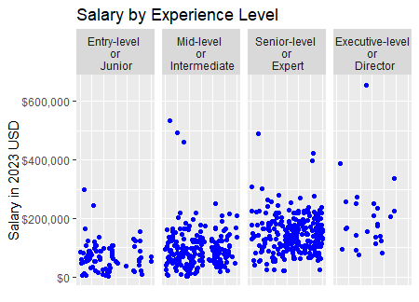
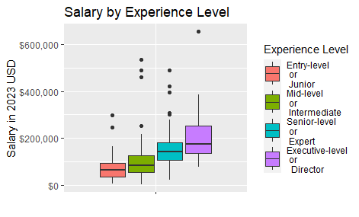
A large view of the employment market
Summary of salary values by experience level:
Experience level | Average salary | Median Salary | Upper 75% Salary | Maximum Salary
Entry-Level/Junior | $71K | $65K | $92K | $297K
Mid-level/ Intermediate | $96K | $82K | $124K | $535K
Senior-level/Expert | $148K | $142K | $182K | $490K
Executive-level/Director | $205K | $175k | $251K | $655K
There is a general upwards trend as experience level increases.
Removing the extreme values changes the maximum salary for each range. These values align more closely with actual upper ranges of expected salary.
Experience level | Average salary | Median Salary | Upper 75% Salary | Maximum Salary
Entry-Level/Junior | $71K | $65K | $92K | $164K
Mid-level/ Intermediate | $96K | $82K | $125K | $218K
Senior-level/Expert | $148K | $142K | $182K | $280K
Executive-level/Director | $205K | $175k | $251K | $386K
Notes:
The overall field was considered for trends.
All salary units were converted to 2023 USD using the Social Security Wage Inflation numbers.

Slide 4
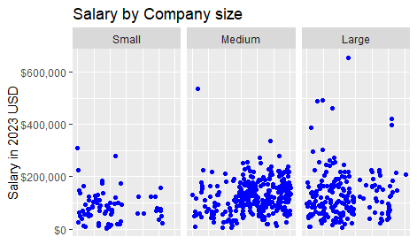
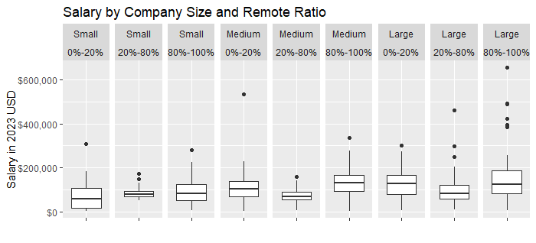
A large view of the employment market
Company Size | Average salary | Median Salary | Upper 75% Salary | Maximum Salary
Small | $85K | $75K | $109K | $309K *$183K
Medium | $125K | $121K | $164K | $535K *$278K
Large | $131K | $109K | $167K | $655K *$301K
Summary of salary values by company size:
We can expect that as our company transitions from a small to large company compensation will increase 50%.
Focusing on Senior-level only we see that the average and median values increased $15,000 and the upper 75% were practically identical
Summary of salary values by company size for Senior-level:
Company Size | Average salary | Median Salary | Upper 75% Salary | Maximum Salary
Small | $132K | $125K | $175K | $309K
Medium | $145K | $142K | $176K | $271K
Large | $160K | $159K | $202K | $301K
Summary of salary considering both the amount of remote working time and company size, without considering the extreme values:
Remote Level Vs. Company Size | Less than 20% | 20%-80% | Greater than 80%
Small | Median: $60K 75%: $109K Max: $183K | Median: $78K 75%: $99K Max: $131K | Median: $84K 75%: $123K Max: $226K
Medium | Median: $103K 75%: $140K Max: $229K | Median: $68K 75%: $90K Max: $142K | Median: $132K 75%: $168K Max: $278K
Large | Median: $127K 75%: $165K Max: $273K | Median: $83K 75%: $122K Max: $205K | Median: $126K 75%: $188K Max: $257K
Depending on the companies expectation for remote work, we will be considering a $20K swing in salary for a small company.
*with outliers removed
Notes:
The entire full time data was then considered in terms of company size, remote ratio and employment level, and for US Residency.
The average salary for a medium company is approximately 147% of the small company salary. Comparing the upper 75%, we find that the medium company is 150% of the small company salary.
An interesting trend is seen from the data in that within each company size. If we consider the mean, 75%, and max pay. In almost every instance the employees in the 20% to 80% remote ratio are paid the least. The next group is the 0% to 20%, and the 100% remote where paid the most.
I suggest hiring a Senior-Level/Expert that could grow into the director. So further analyses on Senior level staff was performed when comparing salary of US and non-US based staff.

Slide 5
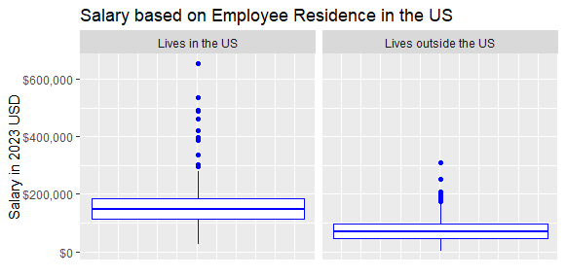
A large view of the employment market
Summary of salary considering US workers verses those in other countries:
Summary of salary considering US workers verses those in other countries for Senior level staff:
Residency | Average salary | Median Salary | Upper 75% Salary | Maximum Salary
Lives in the US | $158K | $149K | $185K | $280K
Lives outside the US | $76K | $68K | $96K | $170K
The average, median and 75% salary values for US residency is almost twice the values of those who live outside the US.
If you hire someone in the Senior-level the salary for someone outside the US is approximately two-thirds the US residency salary for the average, median and 75% salary values .
Residency | Average salary | Median Salary | Upper 75% Salary | Maximum Salary
Lives in the US | $163K | $156K | $190K | $280K
Lives outside the US | $101K | $93K | $125K | $208K

Slide 6
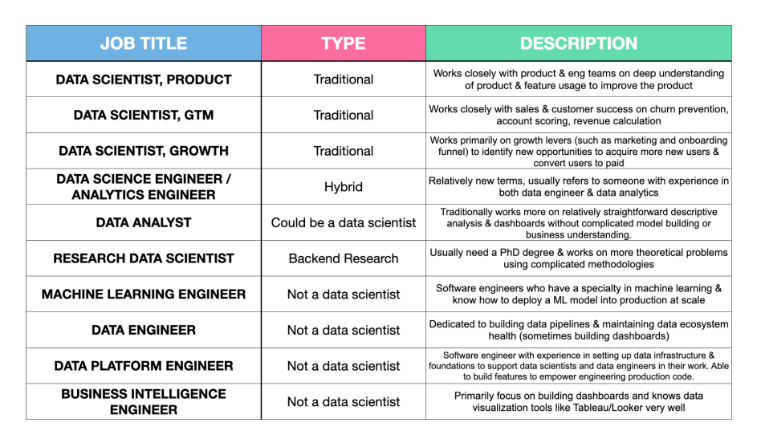
The many types of “data scientists”
see appendix for discussion of skills
Additional possibility- Data scientist with programming experience
(see Appendix)
Top recommendation
Additional possibility- Data engineer with analysis experience
(See Appendix)
* From The Startup Founders Guide to Hiring a Data Scientist by Mengying Li

Slide 7
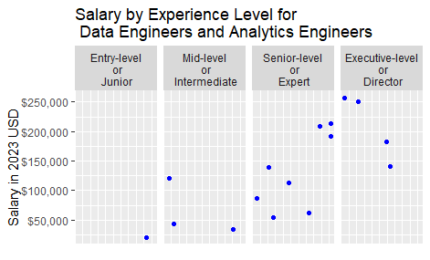
Data Science Engineer or Analytics Engineer
Summary:
Experience level | Average salary | Median Salary | Upper 75% Salary | Maximum Salary
Entry-Level/Junior | $21K | $21K | $21K | $21K
Mid-level/ Intermediate | $66K | $43K | $82K | $120K
Senior-level/Expert | $133K | $125K | $196K | $214K
Executive-level/Director | $207K | $216K | $252K | $257K
I suggest hiring a Senior-Level/Expert that could grow into the director. For top talent, expect to pay between $130,000 and $196,000
Notes:
Analysis was performed on this subset considering, remote ratio, country of residence, and company size; however, the small sample size let to not useful results.

Slide 8
Sources
https://review.firstround.com/the-startup-founders-guide-to-hiring-a-data-scientist#finding-your-first-data-science-hire#who-are-great-data-scientists
https://www.ssa.gov/oact/cola/awidevelop.html
https://www.ssa.gov/oact/TR/TRassum.html

Slide 9
Appendix
Skills needed
Salary bands for Data engineer with Analysis Experience
Salary bands for Data Scientist with Programing experience

Slide 10
Single Hire needs:
DATA ANALYSIS
Work closely with internal teams to gather useful data
Manipulation of data
Analysis of data
DATE ENGINEERING
Data pipeline creation
Data infrastructure
Machine learning (future)
ADDITIONAL SKILLS
Story-teller
Cross-functional communicator
Influencer

Slide 11
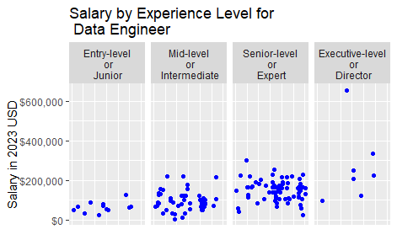
Data engineer with analysis experience
There is a general upwards trend as experience level increases.
Summary:
Experience level | Average salary | Median Salary | Upper 75% Salary | Maximum Salary
Entry-Level/Junior | $63K | $63K | $73K | $125K *$87K
Mid-level/ Intermediate | $94K | $87K | $121K | $218K *$177K
Senior-level/Expert | $149K | $156K | $176K | $301K *$254
Executive-level/Director | $271K | $255K | $295K | $655K *$338K
If we hire a data engineer, one with analysis experience is necessary. For Senior-level or Expert we should expect to pay $150, 000 to $176, 000
*with outliers removed

Slide 12
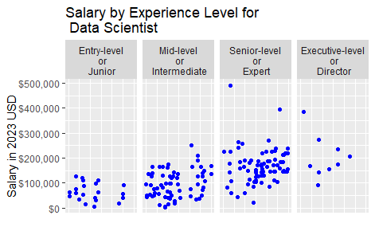
Data Scientist with Programing experience
Summary:
Experience level | Average salary | Median Salary | Upper 75% Salary | Maximum Salary
Entry-Level/Junior | $64K | $59K | $90K | $125K
Mid-level/ Intermediate | $95K | $97K | $135K | $251K
Senior-level/Expert | $167K | $157K | $193K | $490K *$271K
Executive-level/Director | $203K | $174K | $233K | $386K *$273K
I suggest hiring a Senior-Level/Expert Data Scientist that also has programming experience. For top talent, expect to pay between $150,000 and $200,000. For a Data Sceintist with the extra qualification of programming, I would anticipate payingtowards the higher end of this range.
*with outliers removed

